Slide 1

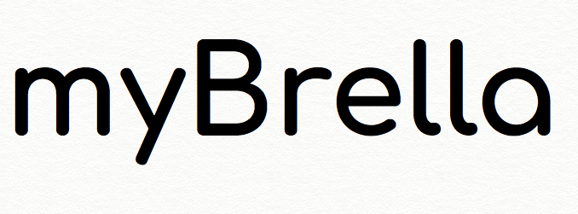
Created & Developed
by:
Justin Kunz
Mary Brown
Stephen Brown
Ingrid R Rowe

Slide 2
An Introduction to
myBrella is an application that allows the user to get weather data tailored to what they want. This application makes it easy for the user to customize alerts for different types of weather conditions. For example, if the user want to know if there will be rain on a particular day, they can set a specific time they wish to receive a weather alert for rain, like 6:30 a.m.

Slide 3
Introduction continued
Problems:
1. Never know when its raining until its too late
2. Weather notifications clutter my message inbox with traditional weather apps
3. I never receive the notifications on time
4. I can’t plan my day accordingly
Solutions
Allow user to customize the time they want notifications
Allow user to specify which weather notification they receive
Gives user flexibility to prepare for their day based on weather

Slide 4
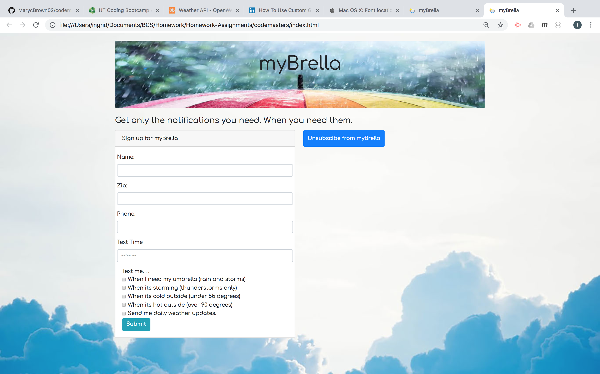

Slide 5
Technologies Used
Bootstrap
Firebase
Appscript
Html/CSS
Java script/Jquery
Open Weather API
Zip API
Twilio API

Slide 6
LIVE DEMO

Slide 7
FINAL THOUGHTS and Q&A

